Slide 1
Improving Scheduling Efficiency For In-Port Shipboard Watch Standing
OA3801 Final Project
LT Thanos, LT Cavanah, LT Harrell-Parada, LT Gallagher

Slide 2
Bottom Line Up Front: BLUF
This project aimed to develop an effective, transparent, and user-friendly method to schedule in-port shipboard watch bills
Watch bill scheduling is often inefficient, error-prone, and unfair
Typical manning of a Greek Navy Frigate used as test-case
Can be extended to any ship with any size crew
A Graphical User Interface (GUI) would enable the Executive Officer (XO) to easily and efficiently create effective watch bills.

Slide 3
Contextual Considerations
Ships need an automated, optimized method to scheduling that ensures:
operational requirements are met
personnel are treated fairly
Currently, XO solicits inputs for the watchbill from Department Heads and compiles manually into a schedule (inefficient and time consuming)
Automating this process saves time and improves quality of product

Slide 4
Defining Watch Bill Requirements
Each day requires 5 scheduled watch standers:
OOD, POOW, Assistant POOW, EOOW, Assistant EOOW
Between duty days, must have 2 days off (e.g. if stand watch Monday can stand another NET Thursday)
Nobody can stand watch for more than 2 holidays/month
Personnel | Maximum Duty Days/Month
Officers | 4
Warrant Officers | 5
Petty Officers | 6
Conscripted Sailors | 15

Slide 5
Input Data and Constraints
Several "helper" python scripts and functions that define constraints:
Scheduler_rules.py - defines maximum days per month and function to control requirement for 2 days between duty days
Scheduling_prep.py - Prepares availability data for duty scheduling
Loads info of ship status and personnel roster
Organize into Pandas dataframes

Slide 6
Define Inputs to the GUI Script
More essential "helper" python scripts and functions:
Export_service.py - script that creates the GUI's output excel sheets
Calendar_service.py - creates functionality in GUI for user to select ship status, leave status, holidays, etc
Scheduler_in_port.py - contains main algorithm that schedules the watch bill based on the constraints
''greedy algorithm'' - once a person who is available runs through the algorithm, they will be scheduled

Slide 7
Creation and Features of the GUI
gui_app.py
Main script that creates GUI interface (Tkinter)
Tab 1: Personnel management
Add/delete/update personnel roster
Tab 2: Leave management
Input personnel leave, export this to excel
Tab 3: User scheduling parameters
input holidays, in-port dates, declare personnel unavailability/preferences

Slide 8
Output of the GUI
Output of GUI:
Daily Calendar (Calendar_YYYY-MM.xlsx)
Daily watch bill for each of the 5 duties
Monthly Summary (Monthly_Summary_YYYY-MM.xlsx)
Statistics for the month's watch bill
Personnel Overview (Personnel.xlsx)

Slide 9
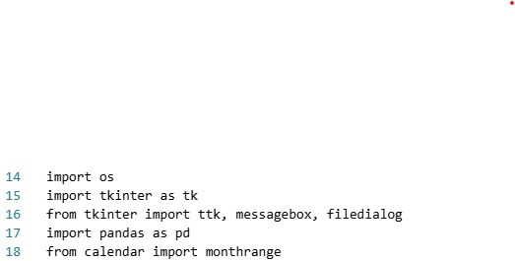
Tkinter
Python's built-in library for creating GUIs
Modules used from Tkinter:
ttk – modern widgets for the GUI (buttons you click)
messagebox – pop-up messages when actions completed/errors arise
filedialog – allows opening of files from operating system
Documentation: (tkinter — Python interface to Tcl/Tk — Python 3.13.7 documentation)

Slide 10
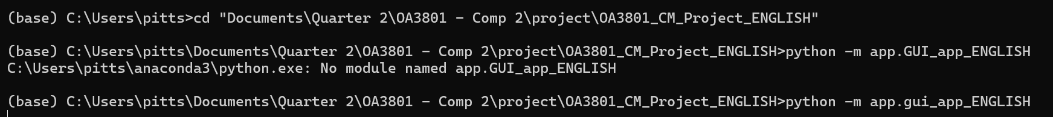
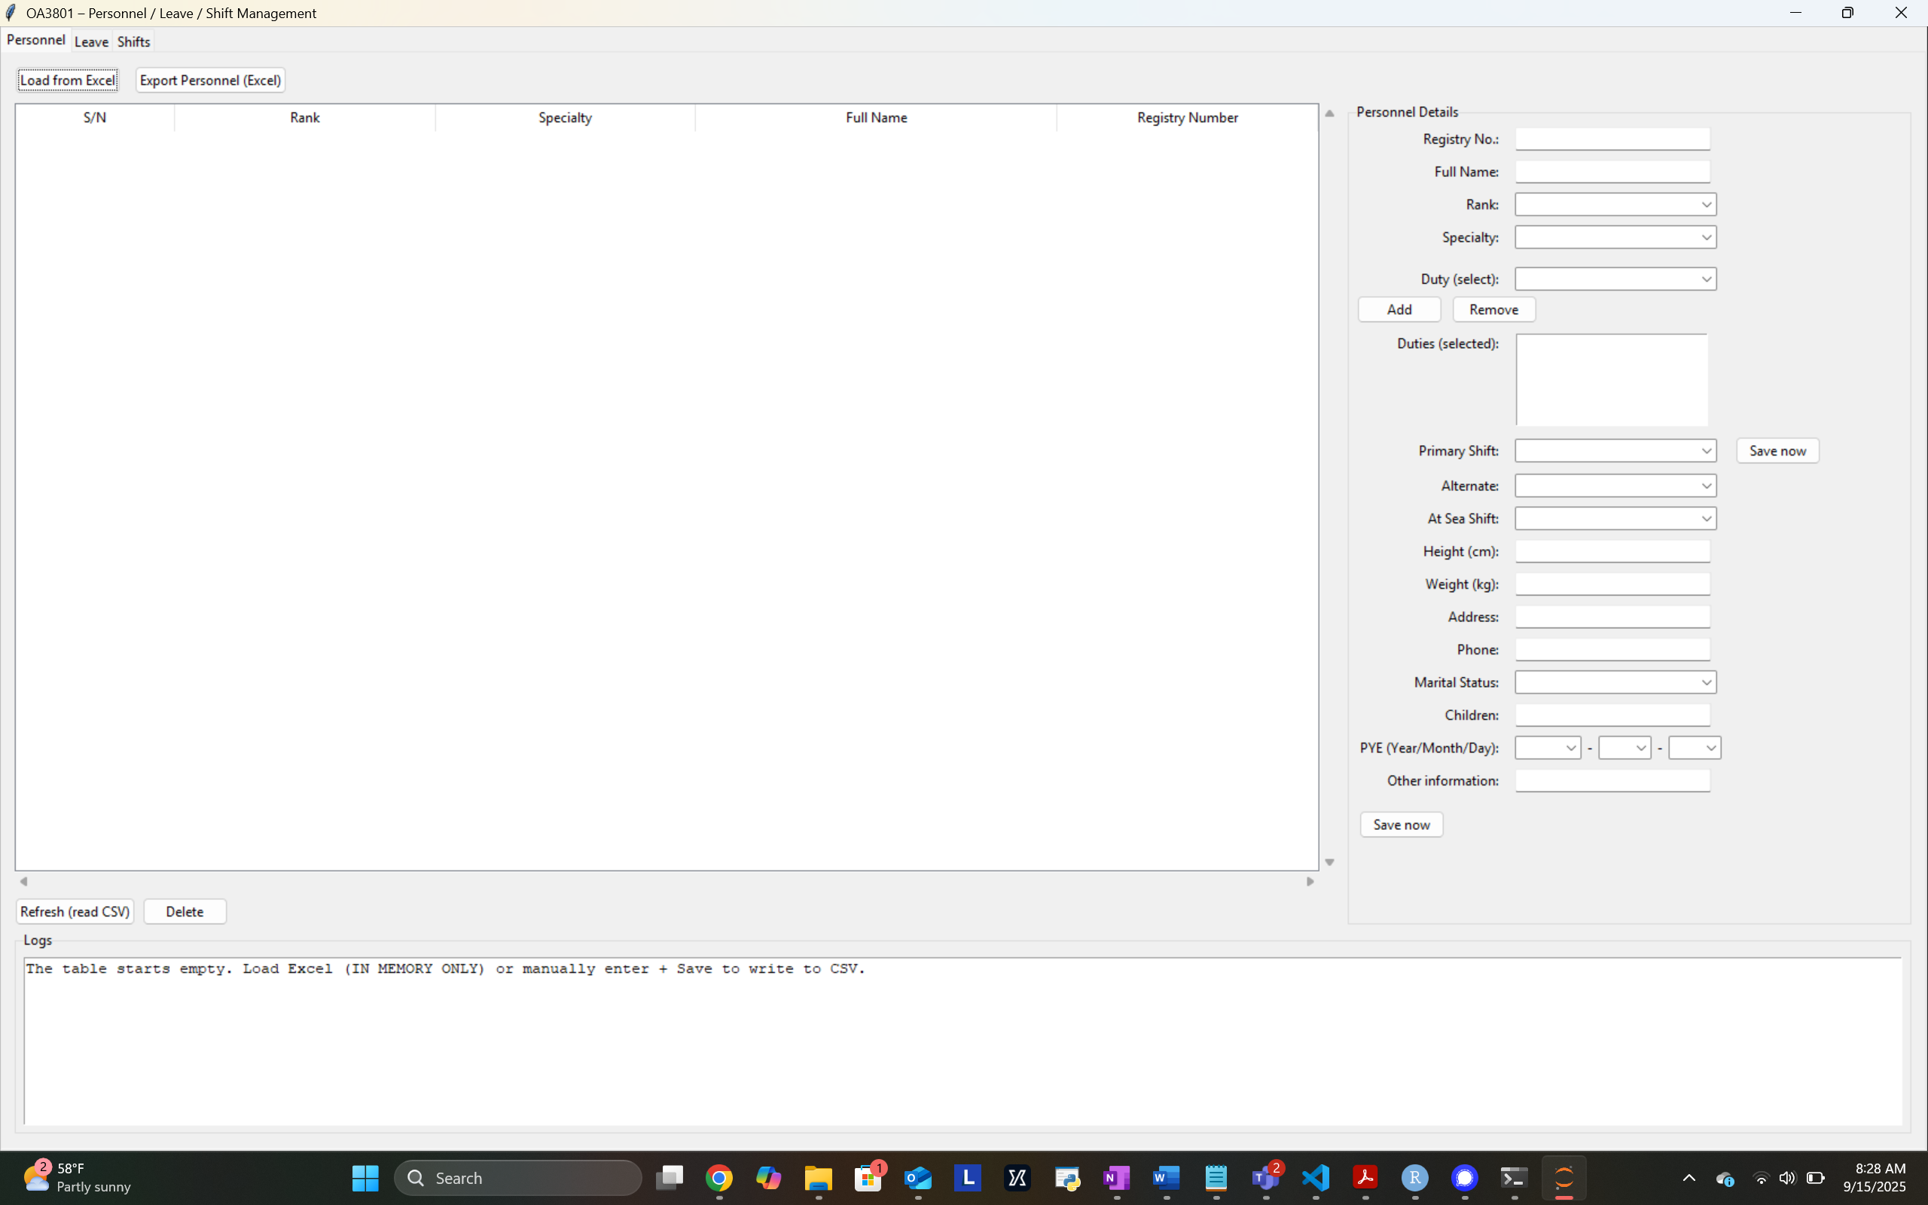
Demonstration
From command line:
python app/gui_app.py

Slide 11
Program Limitations & Future Work
Limitations
Must have some knowledge of how to run a python script
Pop-up messages absent if certain files open – could lead to confusion
Occasional bug of having to restart GUI for all export files and pop-up messages to function ideally
Future Work
eliminate any need to use command line functionality
Make program compatible with unplanned underways
Expand language inputs for the program

Slide 12
Conclusions
The user-friendly GUI interface enables the XO to quickly and effectively create watch bills
Personnel preferences and limitations are considered
Time consuming manual scheduling processes are eliminated
Automating watch bill scheduling would eliminate lengthy manual scheduling and prioritize operational requirements and personnel needs.

